Slide 1

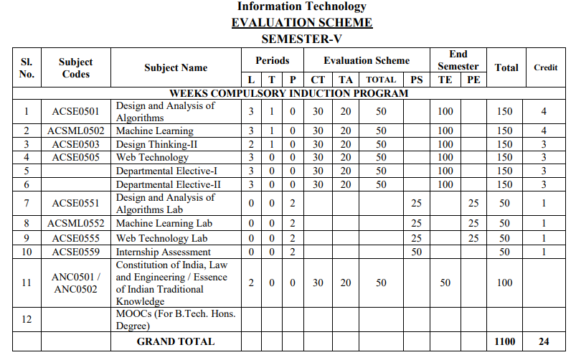
Evaluation Scheme

Slide 2
Syllabus Unit - 1
Introduction: History of Web and Internet, connecting to Internet, Introduction to Internet services and tools, Client-Server Computing, Protocols Governing Web, Basic principles involved in developing a web site, Planning process, Types of Websites, Web Standards and W3C recommendations, Web Hosting Basics, Types of Hosting Packages, Introduction to Web testing, Functional Testing, Usability & Visual Testing, Performance & Load Testing.

Slide 3
Syllabus Unit - 2
HTML: What is HTML, DOM- Introduction to Document Object Model, Basic structure of an HTML document, Mark up Tags, Heading-Paragraphs , Line Breaks, Understand the structure of HTML tables. Lists, Working with Hyperlinks, Image Handling, Understanding Frames and their needs, HTML forms for User inputs. New form Elements- date, number, range, email, search and data list, Understanding audio, video and article tags.
XML: Introduction, Tree, Syntax, Elements, Attributes, Namespaces, Display, HTTP request, Parser, DOM, XPath, XSLT, XQuerry, XLink, Validator, DTD, Schema, Server

Slide 4
Syllabus Unit - 3
Concept of CSS 3: Creating Style Sheet, CSS Properties,CSS Styling(Background, Text Format, Controlling Fonts) , Working with block elements and objects , Working with Lists and Tables , CSS Id and Class, Box Model(Introduction, Border properties, Padding Properties, Margin properties) CSS Advanced(Grouping, Dimension, Display, Positioning, Floating, Align, Pseudo class, Navigation Bar, Image Sprites, Attribute sector) , CSS Color, Creating page Layout and Site.
Bootstrap: Introduction, Bootstrap grid system, Bootstrap Components.

Slide 5
Syllabus Unit - 4
JavaScript Essentials: Introduction to Java Script , Javascript Types , Var, Let and Const Keywords, Operators in JS , Conditions Statements , Java Script Loops, JS Popup Boxes , JS
Events , JS Arrays, Working with Arrays, JS Objects ,JS Functions , Using Java Script in Real time , Validation of Forms, Arrow functions and default arguments, Template Strings, Strings methods, Callback functions, Object de-structuring, Spread and Rest Operator, Typescript fundamentals, Typescript OOPs- Classes, Interfaces, Constructor etc. Decorator and Spread Operator,
Difference == & ===, Asynchronous Programming in ES6, Promise Constructor, Promise with Chain, Promise Race.

Slide 6
Syllabus Unit - 5
Introduction to PHP, Basic Syntax, Variables & Constants, Data Type, Operator & Expressions, Control flow and Decision making statements, Functions, Strings, Arrays,
Working with files and directories: Understanding file& directory, Opening and closing, a file, Coping, renaming and deleting a file, working with directories, Creating and deleting folder, File Uploading & Downloading.
Session & Cookies: Introduction to Session Control, Session Functionality What is a Cookie, Setting Cookies with PHP. Using Cookies with Sessions, Deleting Cookies, Registering Session variables, Destroying the variables and Session.

Slide 7
Text Books
Text books:
1. Steven M. Schafer, “HTML, XHTML, and CSS Bible, 5ed”, Wiley India
2. Ian Pouncey, Richard York, “Beginning CSS: Cascading Style Sheets for Web Design”, Wiley India

Slide 8
Branch Wise Applications
Sample Applications
Desktop GUI Applications
Mobile Applications
Enterprise Applications
Scientific Applications
Web-based Applications
Cloud-based Applications
Web servers and Application servers
Software Tools

Slide 9
Brief Introduction About The Subject
Web technologies are the various tools and techniques that are utilized in the process of communication between different types of devices over the internet.
To understand this term in a better manner, let’s break it down into two pieces: ‘web’ and ‘technology’.
The web, in this case, refers to the World Wide Web, more commonly known as WWW.
It first came into being in 1989 when famous scientist and engineer, Tim Berners-Lee, came up with an efficient mechanism to share resources between scientists all over the world.
https://www.youtube.com/results?search_query=Web+Technonogies

Slide 10
Unit 1 Content
Introduction:
Introduction to Web Technology
History of Web and Internet
Connecting to Internet
Introduction to Internet services and tools
Client-Server Computing, Protocols Governing Web
Basic principles involved in developing a web site
Planning process
Types of Websites
Web Standards and W3C recommendations,

Slide 11
(Cont….)
Web Hosting Basics
Types of Hosting Packages
Introduction to web testing
Functional Testing
Usability & Visual Testing
Performance & Load Testing

Slide 12
Unit Objective
Objective of Unit 1:
To learn about web development strategies with protocols governing web and internet services and tools.
To understand the basic concepts to develop the website as per web standards and W3C recommendations.
To understand web hosting and web hosting packages.
To understand to register a domain and maintain web servers.

Slide 13
Introduction to Web Technology
Web Technology refers to the various tools and techniques that are utilized in the process of communication between different types of devices over the internet.
A web browser is used to access web pages.
Web browsers can be defined as programs that display text, data, pictures, animation, and video on the Internet.

Slide 14
Tools Used in Web technology
World Wide Web (WWW)
Web Browser
Web & Application Server
Web Pages
Internet
Web Development

Slide 15
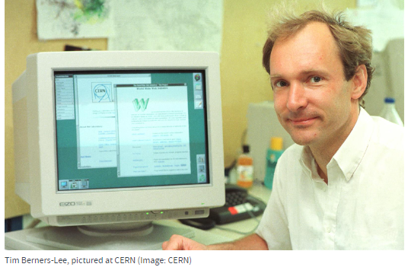
History of Web development and Internet
World Wide Web
The World Wide Web is a system of interlinked hypertext documents accessed via the Internet. Web is a huge collection of pages of information linked to each other around the globe.
History of WWW
Tim Berners-Lee, a British scientist, invented the World Wide Web (WWW) in 1989, while working at CERN.
The basic idea of the WWW was to merge the evolving technologies of computers, data networks and hypertext into a powerful and easy to use global information system.
The first Web page address was http://info.cern.ch/hypertext/WWW/TheProject.html

Slide 16
Conti….
In the fall of 1991, conference goes around the world started hearing about the promise but sparks still were not flying.
In 1993, there are only about 50 websites world wide.
A browser that allowed user to take advantage of the web’s graphical capabilities was developed at the National center for Super Computing application (NCSA).
NCSA called the browser Mosaic.

Slide 17
History of Internet
Definition of Internet
The Internet (or internet) is the global system of interconnected computer networks that uses the Internet protocol suite (TCP/IP)to communicate between networks and devices.
The internet was first envisioned in the form of ARPANET by the Advanced Research Projects Agency (ARPA) of the U.S. government in 1969.

Slide 18
Conti…
Web Browser:- The web browser is an application software to explore www (World Wide Web). It provides an interface between the server and the client and it requests to the server for web documents and services.
It works as a compiler to render HTML which is used to design a webpage.
Each browser usually consists of three parts: a controller, client protocol, and interpreters.
Example:- Google Chrome, Mozilla Firefox and Opera etc.

Slide 19
Conti…
Web Pages:- A web page (or webpage) is a document on the Web that is accessed in a web browser. A website typically consists of many web pages linked together under a common domain name.
Types of Web Page
Static Web Page:- Static web pages are generally written in simpler languages such as HTML, JavaScript, CSS, etc.(static web pages data do not changes until someone changes it manually and hence data is static in nature.)
Dynamic Web Page:- On other Dynamic web pages are written in more complex languages such as CGI, AJAX, ASP, ASP.NET, etc.

Slide 20
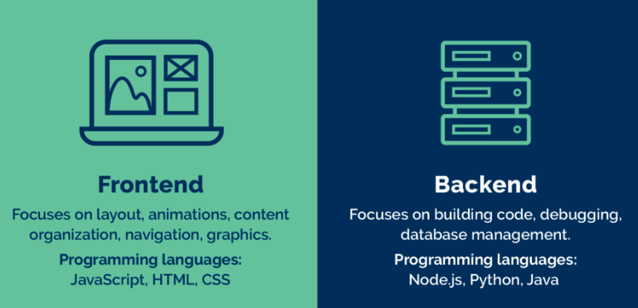
Conti…
Web Development:- Web development refers to the creating, building, and maintaining of websites. It includes aspects such as web design, web publishing, web programming, and database management. It is the creation of an application that works over the internet i.e. websites.
Web Development can be classified into two ways:-
Frontend Development:- HTML,CSS, Java Script, Bootstrap etc.
B. Backend Development:- PHP, Java,SQL etc.

Slide 21
Conti…
Web servers and application servers are the technologies that allow the exchange of data and services over the internet.
Web Server:- A web server is a software component that delivers static data like images, files, and text in response to client requests.
Example:- Nginx, Resin
Application Server :- An application server adds business logic to compute the web server's response. Both terms are used synonymously, and the most popular server software solutions today are hybrid web application servers.
Example:- Glassfish, WebLogic Server and ColdFusion etc.

Slide 22
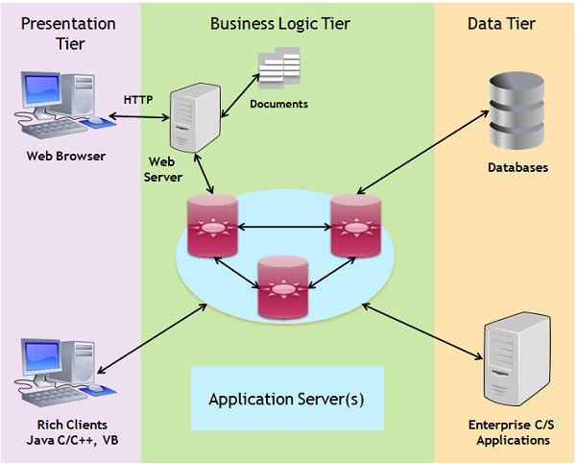
Layer Architecture of Web technology

Slide 23
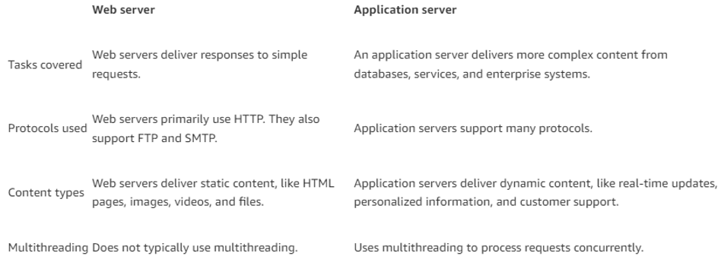
Difference between Web and Application Server

Slide 24
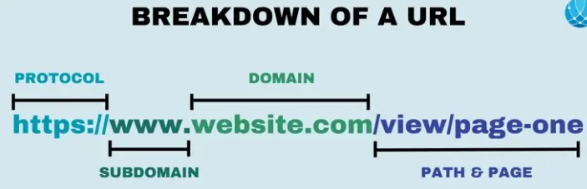
What is URL
A URL (Uniform Resource Locator) is a unique identifier used to locate a resource on the Internet.
It is also referred to as a web address. URLs consist of multiple parts -- including a protocol and domain name -- that tell a web browser how and where to retrieve a resource.

Slide 25
Extra
Web servers and application servers have distinct independent processes. However, they’re invisible to the end user.
Web Server:- A web server is technology that hosts a website’s code and data. When you enter a URL in your browser, the URL is actually the address identifier of the web server.
Your browser and web server communicate as follows:
The browser uses the URL to find the server’s IP address
The browser sends an HTTP request for information
The web server communicates with a database server to find the relevant data
The web server returns static content such as HTML pages, images, videos, or files in an HTTP response to the browser
The browser then displays the information to you

Slide 26
Classification of Web technology
Application Server:- An application server extends the capabilities of a web server by supporting dynamic content generation, application logic, and integration with various resources. It provides a runtime environment where you can run application code and interact with other software components, like messaging systems and databases. It uses business logic to transform data more meaningfully than a web server.
When you attempt to access interactive content on a website, the process works as follows:
The browser uses the URL to finds the server’s IP address
The browser sends an HTTP request for information
The web server transfers the request to the application server
The application server applies business logic and communicates with other servers and third-party systems to fulfill the request
The application server renders a new HTML page and returns it as a response to the web server
The web server returns the response to the browser
The browser displays the information to you
Application Server-
Web Development

Slide 27

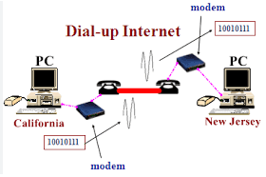

Connecting to Internet
DIAL-UP:- A dial-up connection is established between your computer and the ISP server using a modem. dial-up Connection is a cheap and traditional connection that is not preferred these days as this type of connection is very slow.
BROADBAND:- Broadband refers to high-speed internet access that is faster than traditional dial-up access.
.

Slide 28
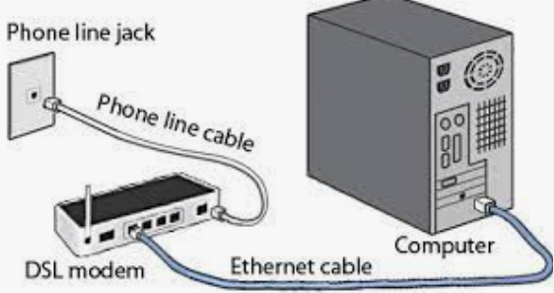
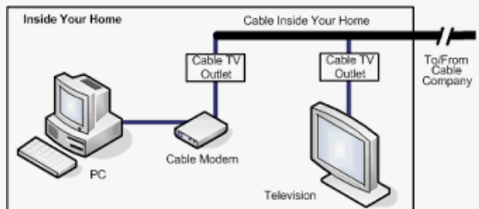
Connecting to Internet
DSL(DIGITAL SUBSCRIBER LINE):- DSL stands for Digital Subscriber Line. It provides an internet connection through the telephone line(network). DSL is a form of broadband communication that is always on, there is no need to dial a phone number to connect.
CABLE:- It is a form of broadband access cable modem that can provide extremely fast access to the internet.

Slide 29
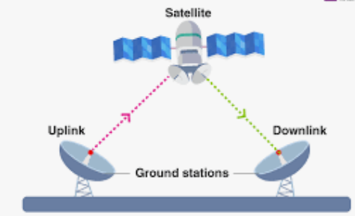
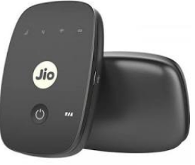
Connecting to Internet
SATELLITE:- This type of connection is provided mainly in rural areas where a broadband connection is not yet offered. It accesses the internet via a satellite that is in Earth’s orbit.
Wireless Connection:- As the name suggests wireless connection does not use telephone lines or cables to connect to the internet. The wireless connection uses a radio frequency band to connect to the internet.

Slide 30
Components Required For Internet Connection
Modem: A device that modulates and demodulates signals for encoding and decoding digital data transmitted over a telephone line or cable system.
Router: A device that routes data from a local network to the internet and vice versa, often includes Wi-Fi capabilities.
ISP (Internet Service Provider): The company that provides internet access to customers.

Slide 31
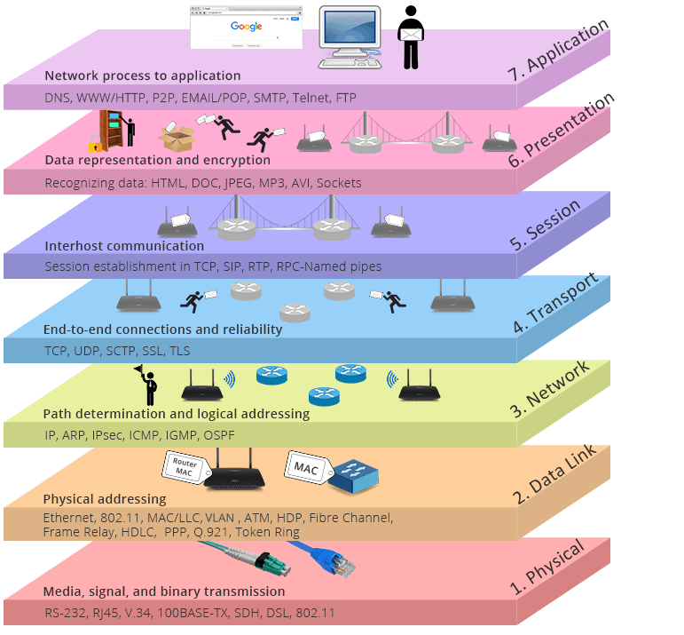
OSI Model
The open systems interconnection (OSI) model is a conceptual model created by the International Organization for Standardization which enables diverse communication systems to communicate using standard protocols.

Slide 32
Protocols & Types of Protocol
Protocol
A protocol is a set of rules that determines how data is sent and received over a network.
Classification of Protocols
Transmission Control Protocol (TCP):Ensures reliable, ordered, and error-checked delivery of data.
Use Case: Commonly used in applications where data integrity is critical, such as web browsing, email, and file transfer.
2. Internet Protocol (IP):-Responsible for addressing and routing packets of data so that they can travel across networks and arrive at the correct destination.
Use Case: Fundamental to the Internet; every device connected to the Internet uses IP.

Slide 33
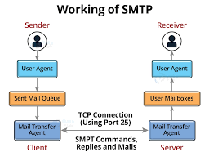
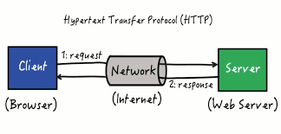
Conti…
3. Simple Mail Transfer Protocol (SMTP):- Used for sending emails.
Use Case: Email servers use SMTP to send and receive mail messages.
4. Hypertext Transfer Protocol (HTTP): Foundation of data communication for the World Wide Web, it defines how messages are formatted and transmitted, and how web servers and browsers should respond to various commands.
Use Case: Used for accessing and retrieving web pages.

Slide 34
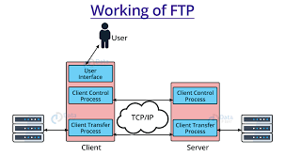
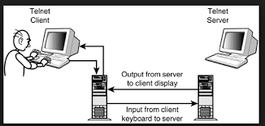
Conti…
7. File Transfer Protocol (FTP): Used to transfer files between a client and a server over a network.
Use Case: Uploading files to a website, downloading files from a server.
8. Telnet Protocol:- Telnet is a network protocol used to provide a command-line interface for communication with a remote device or server. The name stands for "Telecommunication Network.“

Slide 35
Website & Types Of Websites
Website
A website is a collection of web pages relate to one another within the scope of the same domain, containing various information that users can access quickly and easily as long as they are connect to the internet.
Classification of Website
Static Website
Dynamic website

Slide 36
Website & Types Of Websites
Static Website :- The term “static” is use to characterize a lack of movement, motion, or change. A static website is composed of several pre-built files that are kept on a web server. These files written in “client-side” languages such as HTML, CSS, and JavaScript, which run in the user’s web browser. The content is “static,” The only way to modify the website’s appearance is to update the files’ content manually.
Examples of Static Websites:
Resume websites
Portfolio websites
Brochure websites
Blog websites
Newsletter Contents

Slide 37
Website & Types Of Websites
Dynamic Website :- The term “dynamic” refers to something that is constantly changing or progressing. Dynamic websites produce material on the fly by accessing a database. Dynamic content on pages adapted to the demands of the user or visitor behavior.
Dynamic websites are typically created using server-side programming languages such as ASP.NET, JSP,PHP, Ruby Python etc and they interact with a database to retrieve and store data.
Examples of Dynamic Websites:
E-commerce sites
Twitter
Netflix
Facebook
Amazon

Slide 38
Writing a Web Projects
Objective of above Topic:
To developed web project and understand the concepts of web project development differs from traditional web projects
Phases of writing the web projects
Write a project mission statement
Write the specific mission statement that you want to do.
Identify Objectives
Specific
Measurable
Attainable
Realistic
Time limited

Slide 39
Writing a Web Projects(cont1..)
Phases of writing the web projects(cont..)
Identify your target users
The matter of a website will be determined by the users whom you want to visit the site. This is totally depend upon
Market research
Focus group
Understanding the audiences
Determine the scope
By supporting documents and client’s approval.

Slide 40
Writing a Web Projects(cont1..)
Phases of writing the web projects(cont..)
Budget
Assumption for budgets.
Budget categories.
Determine hidden costs and tools.
Planning issues:
Discuss client’s existing information system.
Project team and developing infrastructure.
Where the website will place.

Slide 41
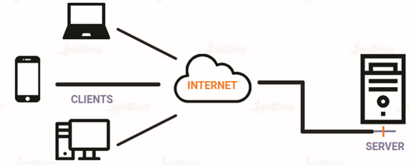
Introduction to client-server computing
Client/Server Definition
Client-server architecture is a computing model in which the server hosts, delivers, and manages most of the resources and services requested by the client.
Simply put, two factors are involved :
A server is the one who provides requested services.
Clients are the ones who request services.

Slide 42
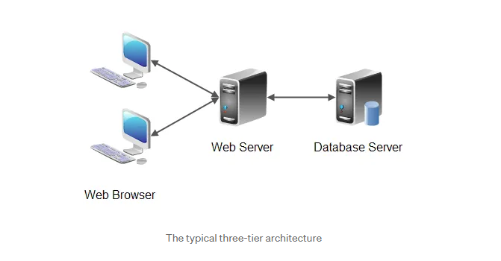
Type of Server

Slide 43

Types of Server
The three types of servers are web servers, application servers and database servers.
Web servers are responsible for hosting websites and delivering web content to users. They handle HTTP requests and responses, serving static web pages, images, and other files. Web servers are essential in the functioning of the internet as they enable users to access websites and interact with web applications. Apache HTTP Server and Nginx are popular web server software used today.
Application servers are designed to host and manage web applications. They provide a runtime environment for executing application code and handle tasks such as session management, security, and database connectivity. Application servers act as a middle layer between web servers and databases, ensuring smooth communication between the two.

Slide 44
Types of Server
The three types of servers are web servers, application servers and database servers.
Iii Database servers are responsible for storing, managing, and retrieving data. They provide a centralized location for data storage and retrieval, ensuring data integrity and security. Database servers handle queries and transactions, allowing applications to interact with the data stored within them. Popular database servers include MySQL, Oracle Database, and Microsoft SQL Server.

Slide 45
Web Standards and W3C recommendations
Web standards are the building blocks of the web. They are the blue prints of how to implement browsers, blogs, graphic editors, search engines, and many more software that power our experience on the web.
W3C(World Wide Web Consortium) recommendation refers to a standard or guideline endorsed by the World Wide Web Consortium.
It is an international organization that develops standards for the World Wide Web (WWW or Web). It was founded in 1994 by Tim Berners-Lee, It has a staff of 443 members- with the main headquarters located in Cambridge
These recommendations are authoritative guidelines for developers and organizations, ensuring consistency ,compatibility and accessibility across different web platforms.
W3C publishes documents that define Web technologies. These documents follow a process designed to promote consensus, fairness, public accountability, and quality.

Slide 46
Standard developed by W3C
CGI
DOM
CSS
HTML
XHTML
HTTP
XML

Slide 47
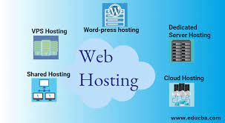
Web Hosting

Slide 48
Web Hosting Basics
Web hosting is a service of providing online space for storage of web pages. These web pages are made available via World Wide Web. The companies which offer website hosting are known as Web hosts.
The servers on which web site is hosted remain switched on 24 x7. These servers are run by web hosting companies. Each server has its own IP address. Since IP addresses are difficult to remember therefore, webmaster points their domain name to the IP address of the server their website is stored on.

Slide 49
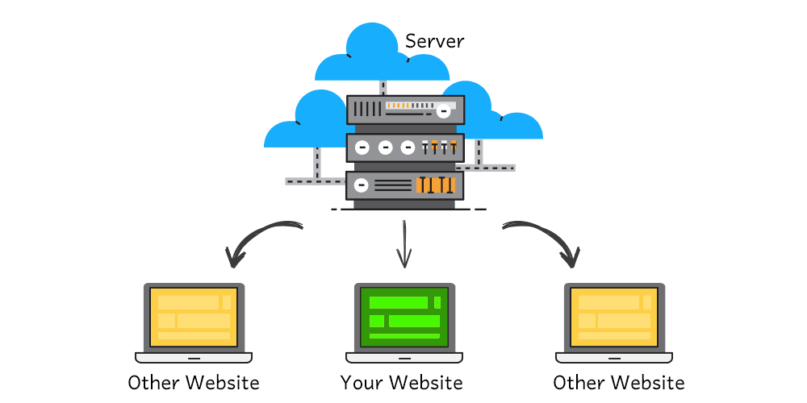
Web Hosting Basics

Slide 50

Types of Web Hosting Packages
There are the six types of web hosting:
Shared hosting
Virtual private server (VPS) hosting
Dedicated server hosting
Cloud hosting
Managed hosting
Colocation

Slide 51
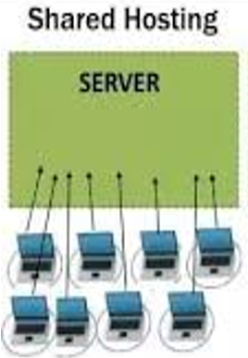
Shared Web Hosting
Shared hosting
Shared hosting allows multiple websites to utilize a single server. Usually, you’ll have no idea who or what websites you’re sharing the resources of a server with. Each customer will usually have a limit on the total amount of server resources they can use, but this will be defined by your hosting package.
Shared hosting is easily the cheapest and most economical option for your needs. However, the cheap price comes with limitations, which we’ll get to below. Since most hosting companies will offer the same amount of space and storage it’s important to choose a company you can trust.

Slide 52
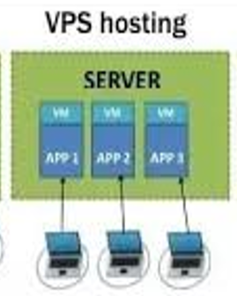
Virtual private server (VPS) hosting
It is also known as Virtual Dedicated Server.
It is a server which is partitioned into smaller servers.
In this customer is given their own partition, which is installed with its own operating system. Unlike shared hosting, VPS doesn’t share memory or processor time rather it allocates certain amount of memory and CPU to use which means that any problem on a VPS partition on the same drive will not affect other VPS customers.

Slide 53
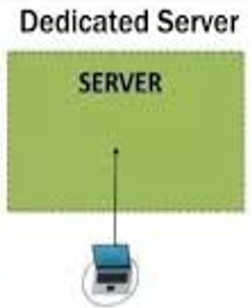
Dedicated server hosting
It provides the website owners the most control over the server that their website is stored on.
Customer has full root and admin access, so he can control everything from security to operating system that you run.
Dedicated servers cost are one of the most expensive web hosting options.
Used by website owners with high levels of website traffic, and those who are in need of complete control of their servers.
A high level of technical expertise is required for the installation and ongoing management of the server.

Slide 54
Managed hosting
Hosting companies provide technical services such as hardware and software setup and configuration, maintenance, hardware replacement, technical support, patching, updating and monitoring.
With managed hosting, the provider looks after the day-to-day management of the hardware, operating systems and standardized applications.

Slide 55
Cloud hosting
It’s a hosting solution that works via a network and enables companies to consume the computing resource like a utility.
This allows users to employ as many resources as they need without having to build and maintain their own computing infrastructure.
Cloud-based hosting is scalable, meaning your site can grow over time, using as many resources as it requires and while the website owner only pays for what they need.

Slide 56
Colocation Hosting
A colocation hosting service is very similar to dedicated hosting, in that it offers you lots of ways to upgrade your website and its resources. It's also more secure and more reliable, but you'll need some understanding to get the most out of it, because with colocation you don't use the hosting company's servers.
You buy or rent all your own hardware and software, and you rent the space in the data center they’re sitting in.

Slide 57
Introduction to Web Testing
Web testing, is simply checking your web application or your website for problems before you make that web application or website live. Web testing is designed to check all aspects of the web application’s functionality, including looking for bugs with usability, compatibility, security, and general performance.
Web testing is a crucial part of assembling any web application or website, as you don’t want to invest the many resources in time and money you’ve spent developing this web application and then have it run into immediate problems upon release.

Slide 58
Functional Testing
Functional testing is a stage in the software delivery lifecycle (also referred to as a ‘process’) in which quality engineers verify whether the application under test’s features behaves as per their requirements.
Here are some typical examples of functional testing:
Do appropriate error messages appear when users input the incorrect information (e.g. invalid email address, card number)?
Can users request to change their credentials (e.g. user name, passwords, etc.,...)?
Can users log in with the new credentials?

Slide 59
Functional Testing Vs Non Functional Testing
 | Functional Testing | Non-functional testing
Method | Normally performed under the black-box method. In which the testers only validate with inputs and outputs instead of the internal structure of the system. | Normally performed under the white-box method. In which the tester is made aware of the system’s internal design to generate test cases accordingly.
Areas of concern | Whether or not the system’s outputs satisfy the specification or requirements given | The system’s performance, stability, security, usability, etc.
Inputs | Business requirements, client’s specifications | Speed, throughput, scalability, etc.
Examples | Unit testing API testing Regression testing (can be both functional and non-functional) | Security testing Performance testing Load testing Stress testing

Slide 60
Performance & Load Testing
Performance testing is a type of testing that is performed for verifying the performance of a system and to monitor the behavior of the system under stress. It tells about the reliability, stability, response time, and scalability of a system. On the other hand, load testing is primarily aimed for identifying the behavior of a system under the expected load.
What is Performance Testing?
Performance testing is performed over the software to test its performance under a particular workload for its sensitivity, reaction time and its stability. Performance testing is basically a superset of stress testing.
The primary goal of performing performance testing is to set the standards and benchmarks for the product. Performance testing indicates how the product behaves under regular parameters. Checking for concurrent users and response time is an example of performance testing.

Slide 61
Performance & Load Testing
Load testing checks the performance of a software to check its performance under real life-based loads.
It is a type of testing that checks the behavior of a system under the expected load. To perform the load testing of a system, we first need to know the expected load on the application in real life.

Slide 62
Performance & Load Testing
Load testing collects all the data about response time, reliability, and stability of the system, and then analyzes the data to find the inconsistencies. Basically, the load test is performed to ensure the stable operation of a system under an expected load.
The greatest advantage of load testing is that it helps in understanding the expected load that a system can handle so that we can reduce the risk of a failure.

Slide 63
Performance & Load Testing
Key | Performance Testing | Load Testing
Purpose | Tests the system performance under varying loads. | System performance for multiple users using the application at the same time.
Threshold | Conducted at below and above threshold limits. | Conducted at threshold limits.
Result | Ensures that the system is performing perfectly under varying loads. | Ensures that the system can handle how many users at a time without performance degradation.
Result | Checks the performance of the system. | Checks the operational capacity of the system.
Cost | Tools are not much costly. | Load testing tools are very costly.
Targets | Checks the reliability, scalability, and speed of the system. | Load testing checks the sustainability of the system.

Slide 64
Usability & Visual Testing
Usability testing refers to evaluating a product or service by testing it with representative users. Typically, during a test, participants will try to complete typical tasks while observers watch, listen and takes notes. The goal is to identify any usability problems, collect qualitative and quantitative data and determine the participant's satisfaction with the product.
To run an effective usability test, you need to develop a solid test plan, recruit participants, and then analyze and report your findings.

Slide 65
Visual Testing
Visual testing is a software testing technique that evaluates the visual appearance and behavior of a software application’s user interface (UI) or graphical user interface (GUI).
Visual testing aims to verify that the application’s visual elements like colors, images, fonts, and layouts, are displayed correctly and consistently across different devices, operating systems, and browsers.​

Slide 66
Visual Testing
Visual testing ensures that the user interface (UI) of the developed product appears as intended for users. It accomplishes this through several key benefits, including:
Identifying defects or issues in the UI interface.
Detecting variations in the UI that do not match the baseline snapshots.
Creating specialized visual test cases that cover functional points.
Identify visual bugs on different browsers.

Slide 67
Thank You

